Slide 1
CHAPTER 14: Communication Channel Technology
The Architecture of Computer Hardware, Systems Software & Networking: An Information Technology Approach
4th Edition, Irv Englander
John Wiley and Sons ©2010

Slide 2
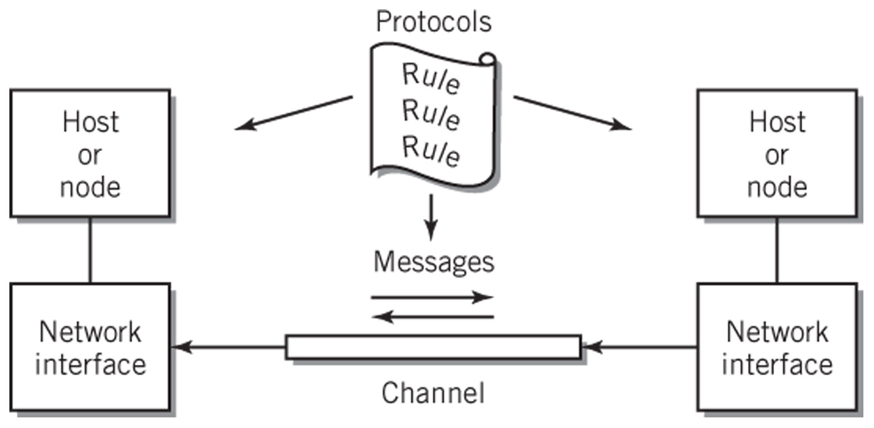
Communication Channel

Slide 3
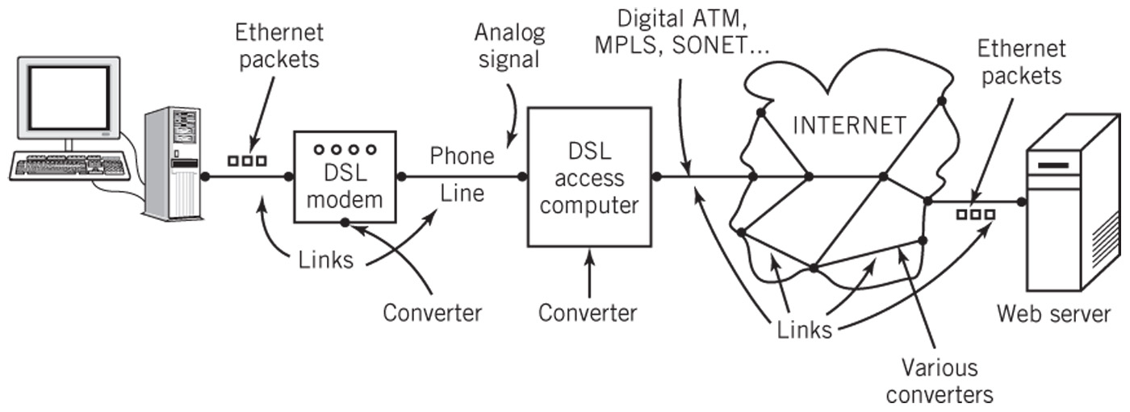
Communication Channels: Many Ways to Implement
Signal: specific data transmitted
Diagram shows a multi-link channel connecting a client (home computer) with a web server
Physically: signal passes through different channel forms including audio, digital, light, radio
Converters between separate channel links

Slide 4
Communication Channel
Characterized by
Signaling transmission method
Bandwidth: amount of data transmitted in a fixed amount of time
Direction(s) in which signal can flow
Noise, attenuation, and distortion characteristics
Time delay and time jitter
Medium used

Slide 5
Channel Organization
Point to point channels
Simplex: channel passes data in one direction only (TV and radio broadcast)
Half-duplex: transmits data one direction at a time (walkie-talkie)
Full-duplex: transmits data in both directions simultaneously (telephone)
Multipoint: broadcasts messages to all connected receivers

Slide 6
Multiplexing
Carrying multiple messages over a channel simultaneously
TDM (time division multiplexing)
Example: packet switching on the Internet
Use: digital channels
FDM (frequency division multiplexing)
Example: Cable TV
Analog channels
Synchronized switches or filters separate different data signals at receiving end

Slide 7
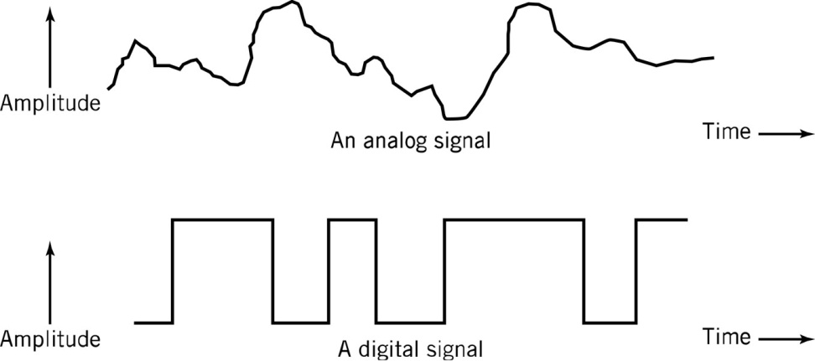
Signaling Transmission Method
Signals are the means used to communicate data
Choice depends on medium and signal characteristics
Analog
Signal takes on a continuous range of values
Discrete
Signal takes on only finite, countable set of values
Digital
Binary discrete signal
Frequently preferred because less susceptible to noise and interference
A discrete signal Time →
Waveform – a representation of a signal shown as a function of time

Slide 8
Signaling Technology
Signal carriers
Electrical voltage
Electromagnetic radio wave
Switched light
Data represented by changes in the signal as a function of time

Slide 9
Transformation between Digital and Analog
Ideally conversion should be reversible
Limitations
Noise: interference from sources like radio waves, electrical wires, and bad connections that alter the data
Attenuation: normal reduction in signal strength during transmission caused by the transmission medium
Distortion: alteration in the data signal caused by the communication channel
Compensation – error correction techniques
Digital → Analog → Digital
Ability to perfectly represent digital data in analog form
Possible to recover the original digital data exactly
Analog → Digital → Analog
Small information loss results from converting analog to digital

Slide 10
Analog Signals
Wireless networking
Most telephones
Satellites
Microwave communications
Radio and sound
Radio waves can be converted to electrical signals for use with wire media for mixed digital and analog data
Example: Cable TV with digital Internet feed

Slide 11
Sine Waves
Occur naturally throughout nature
Sound, radio waves, light
Basic unit of analog transmission
Properties
Amplitude: wave height or power
Period: amount of time to trace one complete cycle of the wave
Wavelength : distance spanned by a sine wave in space
Frequency: cycles per second, i.e., number of times sine wave repeated per second
1 Hertz = 1 cycle/sec
Unit of bandwidth for analog device
Phase
The difference in position of a sine wave with respect to a reference sine wave

Slide 12
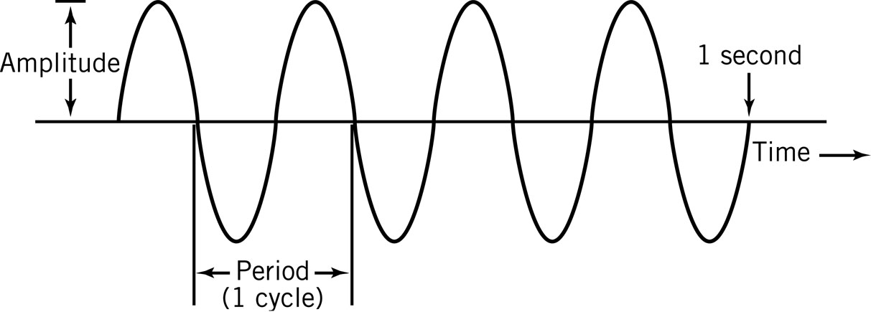
Sine Wave
f = 1/T f is the frequency of the sine wave, where T is the period measured in seconds If f=4Hz then T=1/f=1/4=0.25s T is a reciprocal of f
λ = c/f λ is the wavelength of the sine wave and c is the
speed of light

Slide 13
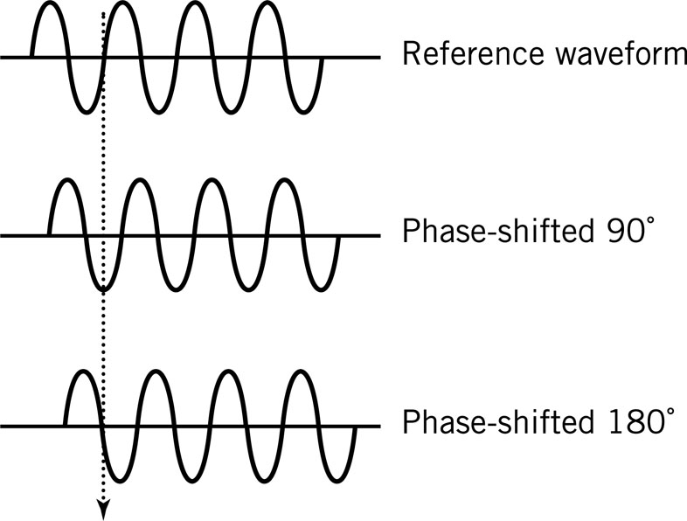
Phase-Shifted Sine Waves
The difference in position of a sine wave with respect to a reference sine wave
Measured in degrees, from 0º to 360º
90º – jumping forward one-quarter of the cycle
180º – jumping forward one-half of the cycle

Slide 14
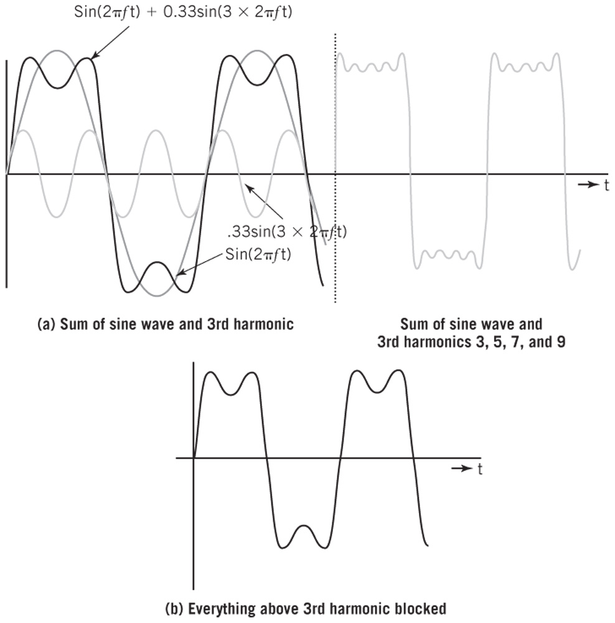
Creating a Square Wave from Sine Waves
All waveforms can be represented as the sum of sine waves of different frequencies, phases, and amplitudes - A digital waveform is a composition of analog sine waves

Slide 15
Properties of Signals/Waveforms
Spectrum, bandwidth, filtering
Spectrum: frequencies that make up a signal
Range of frequencies that a signal spans from minimum to maximum
Average voice has a frequency range of roughly 300 Hz to 3400 Hz
The spectrum would thus be 300 - 3400 Hz
Bandwidth: range of frequencies passed by the channel with a small amount of attenuation
The absolute value of the difference between the lowest and highest frequencies of a signal
The bandwidth would be 3100 Hz calculated as |3400Hz – 300 Hz|
effective bandwidth < bandwidth because noise degrades original signals
Filtering: controlling the channel bandwidth to prevent interference from other signals

Slide 16
Signal Frequencies
The bandwidth required for different types of signals depends on the application
Sound waves: approximately 20 Hz to 20 KHz
Stereo systems: 20-20,000 Hz for high fidelity
Phones: 0-4000 Hz for voice but limits speed
Electromagnetic radio waves: 60 Hz to 300 GHz
AM radio: 550 KHz to 1.6 MHz
20 KHz bandwidth centered around dial frequency of the station
Guard bands prevent stations/signals from interfering
FM radio: 88 MHz to 108 MHz
100 KHz bandwidth per station
TV: 54 MHz to 700 MHz
>4.5 MHz bandwidth per channel
Cell phones, Wi-Fi wireless networks: 800 MHz to 5.2GHz

Slide 17
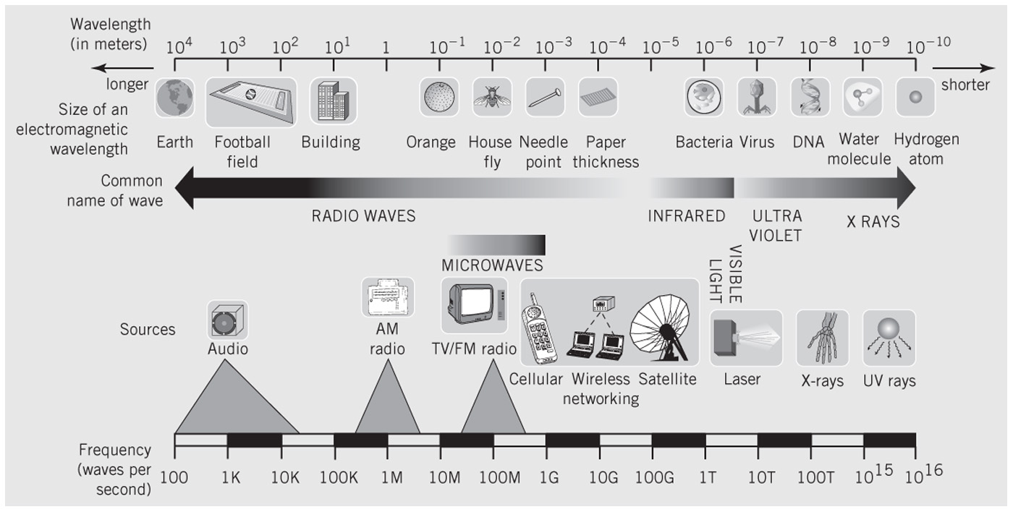
Signal Frequencies
A general map of the useful frequency spectrums

Slide 18
Sine Waves as Carriers
A sound made up of a sine wave produces a single, pure tone
A 440 Hz sine wave produces the tone called A
A 1650 Hz sine wave used by the modem is the carrier frequency and it alone does not carry any information
To represent the signal modulate one of the three characteristics – amplitude, frequency, phase
An AM radio station at 1100 KHz modulates amplitude of the 1100 KHz sine wave carrier to correspond to the sound of music
Demodulator or detector restores original waveform

Slide 19
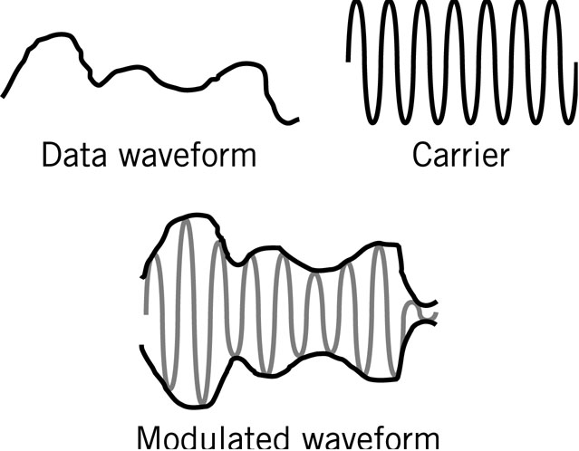
Amplitude Modulations
Analog data can be transmitting with analog carrier signals. The data waveform and carrier are essentially added together to produce modulated waveform. The modulated waveform follows the same outline as the data waveform.

Slide 20
Modulating Digital Signals
Analog data can be transmitted with digital carrier signals
The carrier signal is modulated with only two possible values: 0 and 1
3 techniques
ASK: amplitude shift keying
Represents data by holding the frequency constant while varying the amplitude
FSK: frequency shift keying
Represents data by holding the amplitude constant while varying the frequency
PSK: phase shift keying
Represents data by an instantaneous shift in the phase or a switching between two signals of different phases

Slide 21
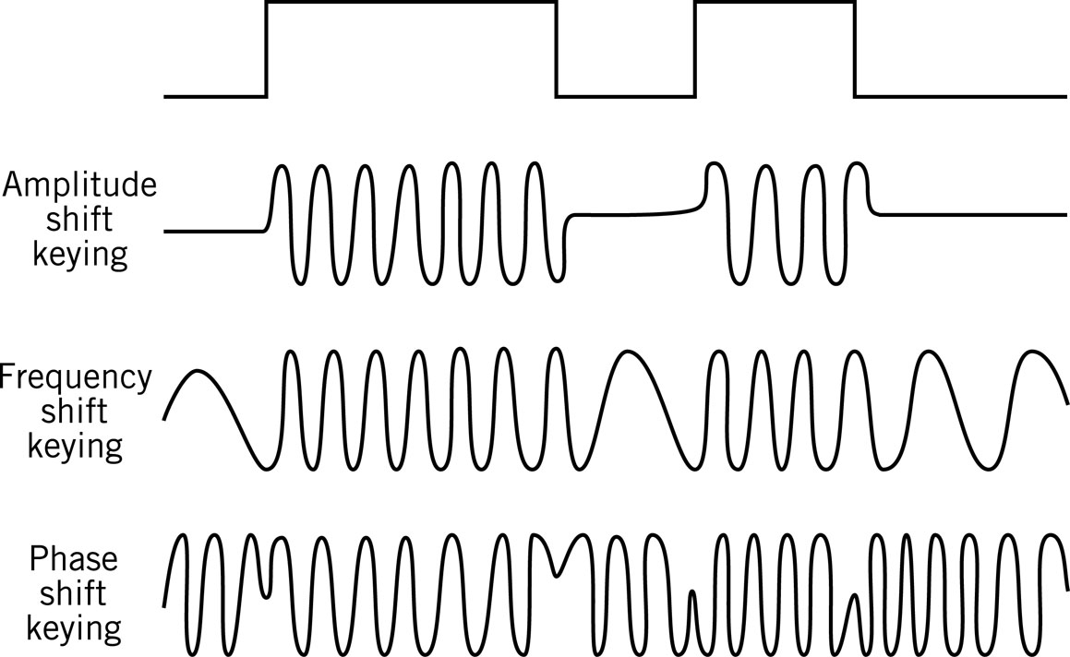
Modulating Digital Signals

Slide 22
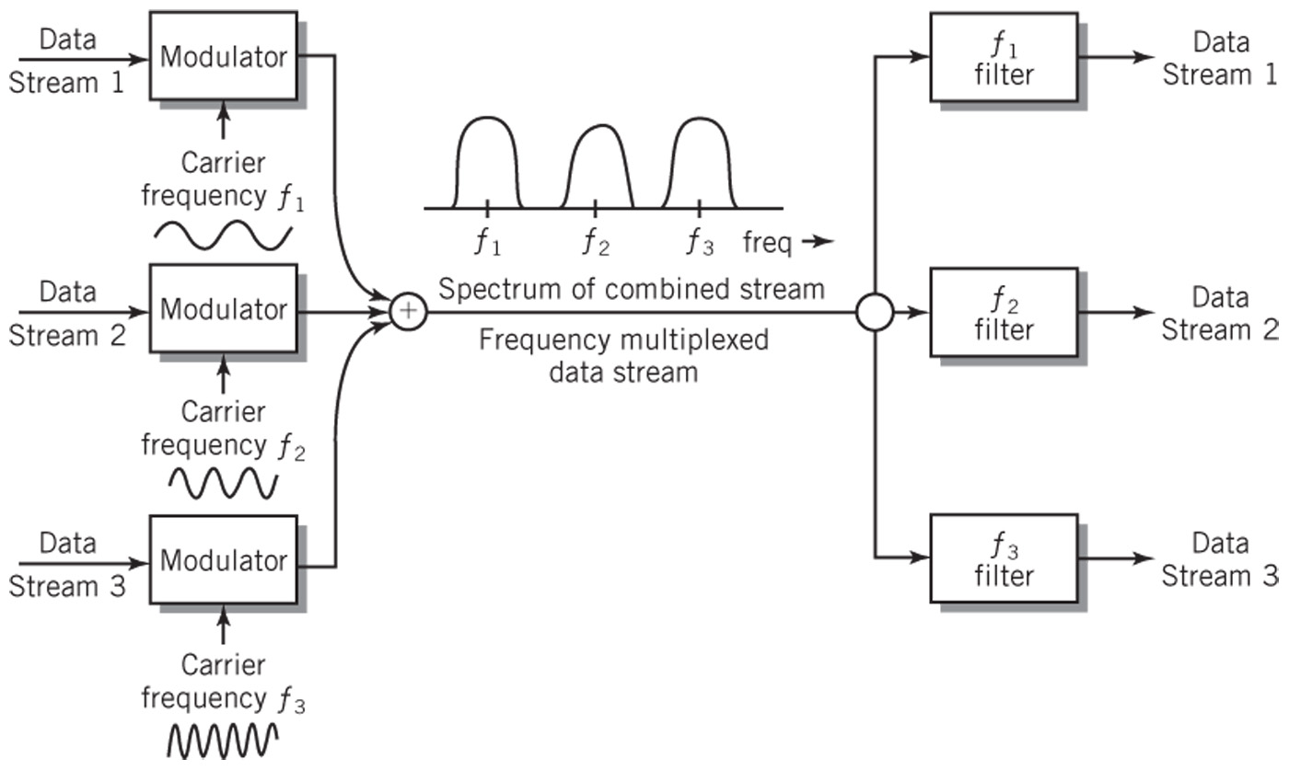
Frequency Division Multiplexing
Optical form of frequency division multiplexing (FDM) is known as wavelength division multiplexing (WDM). Light of different colors have different wavelengths (frequencies). Data signals can be modulated with different carrier wavelengths to carry these data signals simultaneously over the same fiber-optic cable.

Slide 23
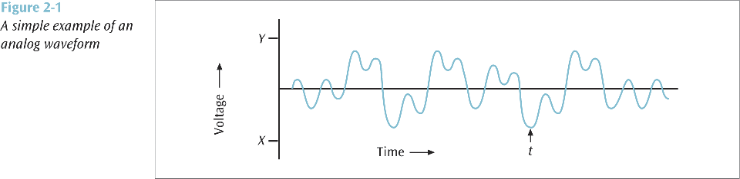
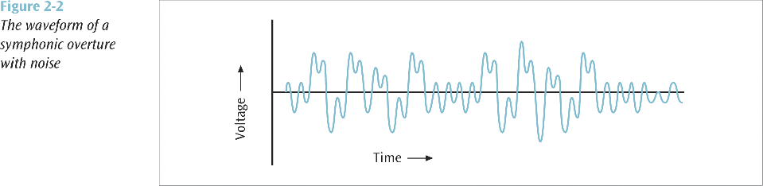
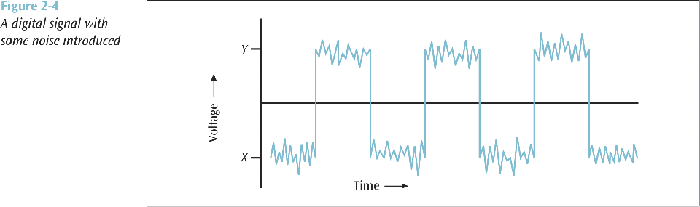
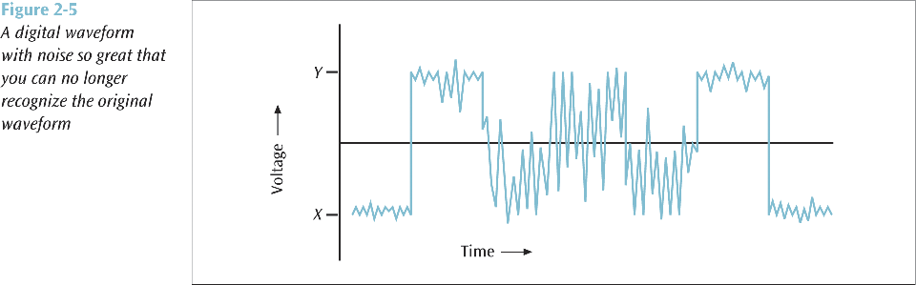
Noise
Unwanted electrical or electromagnetic energy that degrades the quality of signals and data
Can appear in analog data modulated with analog signals, and analog data modulated with digital signals

Slide 24
Attenuation – Signal Loss
Reduction of a signal that occurs in a medium as a function of the physical length of the channel
More difficult to separate the signal from noise at higher transmission speeds
Signal-to-noise ratio should be high
Amplifiers: restore original strength of the signal (but also amplifies noise)
Signal loss/gain is measured in decibels [dB]
Loss or Gain [dB] = 10 log₁₀ (P2/P1)
P2 and P1 are the ending and beginning power levels, respectively, expressed in watts
What is the decibel loss of a signal that starts at point A with a strength of 2000 watts and ends at point B with the strength of 400 watts?
Loss [dB] = 10 log₁₀ (P2 / P1) = 10 log₁₀ (400 / 2000) = 10 log₁₀ (.2) = 10 (-0.699) ≈ -7 dB

Slide 25
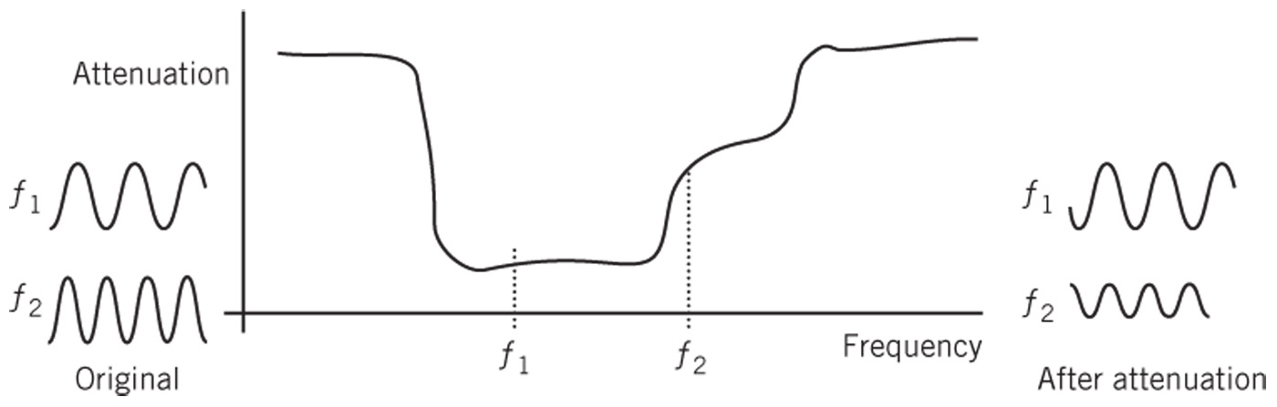
Effects of Attenuation
Loss of amplitude and phase shifts vary with the frequency of the signal
Example: If the signal consists of sine waves of frequencies f₁ and f₂ from different parts of the spectrum, the output of the channel will be distorted

Slide 26
Digital Signaling
Digital data transmitted with digital signals
Data is already in the correct format
So everything seems to be easy
A 1 or 0 could be transmitted as a positive voltage or zero voltage, respectively
But
How do you transmit a series of 10 consecutive 0s?
How do you distinguish between a 0 signal and no signal?
How do you group bits into bytes on the receiving end?

Slide 27
Synchronizing Digital Signals
Synchronizing digital signals difficult
Asynchronous transmission
Clear start and stop signals
Small number of bits, usually one byte
Use: low-speed modems, Ethernet frames
Synchronous transmission
Continuous digital signal
Use: high-speed modems and point-to-point methods

Slide 28
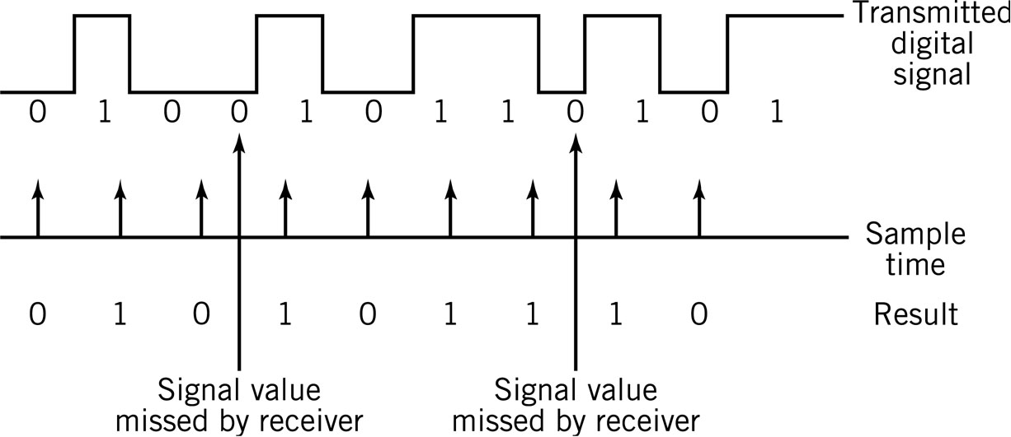
Reception Errors
Timing mismatch between sending and receiving computers
Inability to distinguish groups of 1’s or 0’s

Slide 29
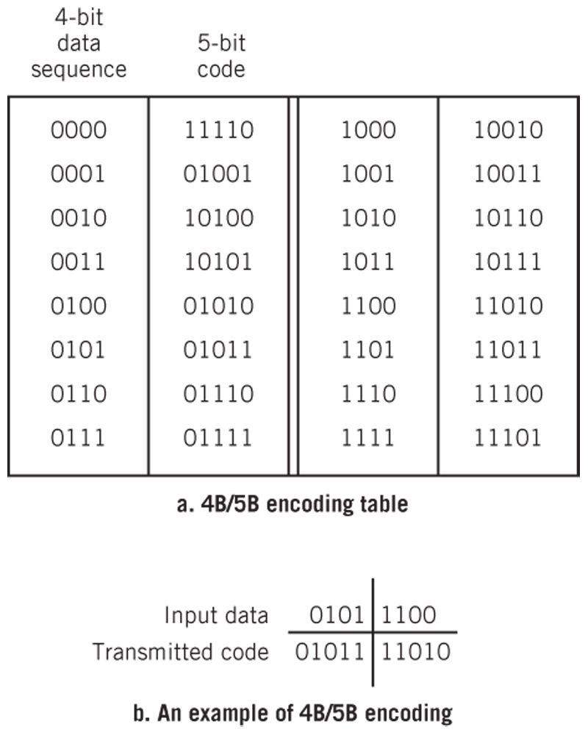
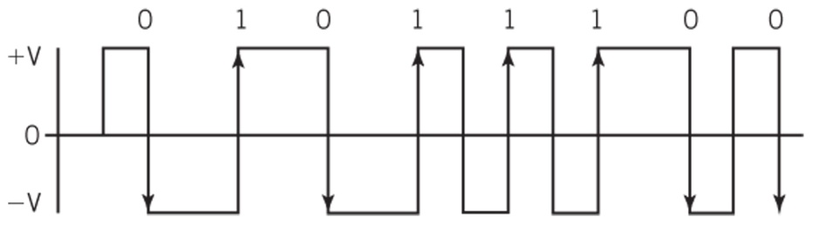
Block and Manchester Encoding
Block Encoding
Manchester Encoding

Slide 30
A-to-D Conversion
Digital signals used to represent analog waveforms
Examples:
CDs, DVDs
Direct satellite TV,
VOIP
Telephone voice mail
Streaming video
A-to-D Pulse Code Modulation

Slide 31
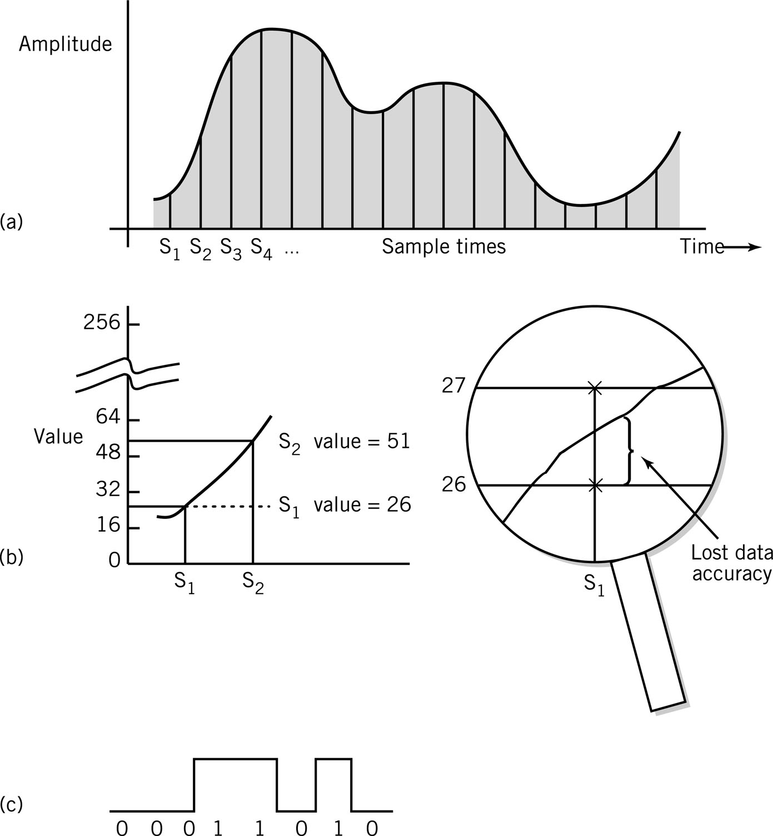
A-to-D: Pulse Code Modulation
Analog waveform sampled at regular time intervals
Maximum amplitude divided into intervals
Example: 256 levels requires 8 bits/sample

Slide 32
A-to-D: Pulse Code Modulation
Sample values converted into corresponding number value
Information lost in conversion
How to increase the accuracy of conversion?
Use 16 bits/sample. You will have 65536 levels.

Slide 33
A-to-D: Pulse Code Modulation
Number reduced to binary equivalent
26 represented as a stream of 8 bits: 00011010
26 represented as a stream of 16 bits:
00000000 00011010

Slide 34
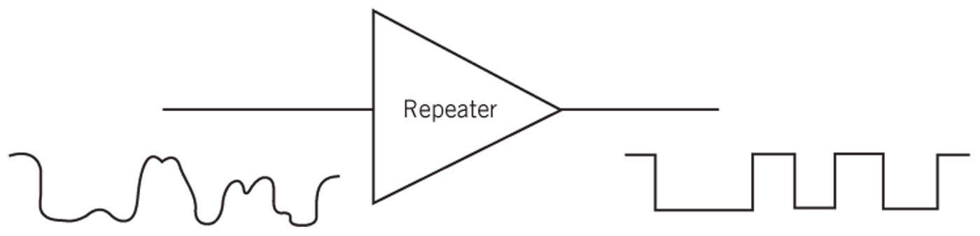
Digital Signal Quality
Subject to noise, attenuation, distortion like analog
Signal quality less affected because only necessary to distinguish 2 levels
Repeaters
Recreate signals at intervals
Use: transmit signals over long distances
Error correction techniques available

Slide 35
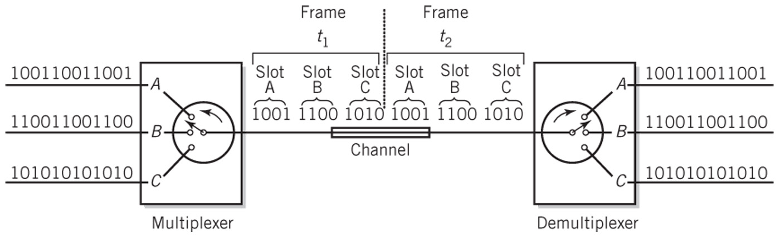
Time Division Multiplexing
TDM - multiple signals share channel

Slide 36
Bandwidth
Digital signals: sum of sine waves of different frequencies
Higher frequencies: higher data rates
Channel with wider bandwidth has higher data rates
Data rates usually measured in bits per second

Slide 37
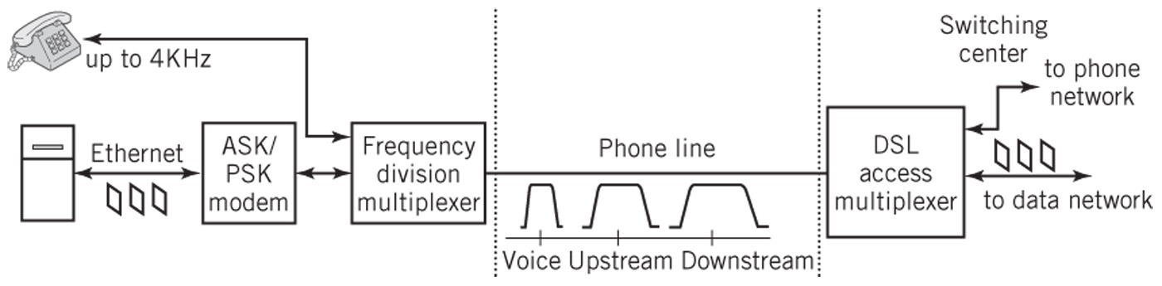
Modems
Modem (modulator/demodulator)
Convert digital signals to analog and back
Use: home to service provider via phone line or cable
Speed: baud rate or bits per second (bps)
DSL

Slide 38
Transmission Media
Means used to carry signal
Characterized by
Physical properties Bandwidth
Signaling method(s) Sensitivity to noise
Guided media: confine signal physically to some kind of cable
Unguided media: broadcast openly
Signal-to-noise ratio
Higher ratio for given bandwidth increases data capacity of the channel

Slide 39
Electrical Media
Require complete circuit
2 wires: one to carry the signal, second as a return to complete the circuit
Wired media or just wire
Inexpensive and easy to use
Signals carried as changing electrical voltage or current

Slide 40

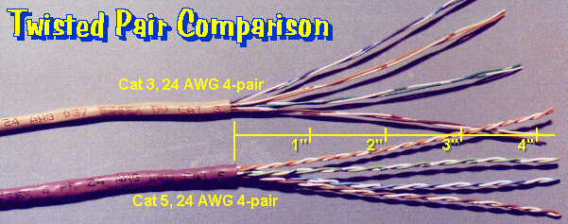
Types of Cable: Copper
Coaxial cable
Wire surrounded by insulation
Copper shield around insulation
Acts as signal return
Shields from external noise
High bandwidth: 100 Mbps
Example: analog cable TV with FDM for dozens of channels at 6 MHz
Twisted pair
Most local area networks; phone lines in buildings
More susceptible to noise than coaxial cable
Used for shorter distances and slower signals

Slide 41
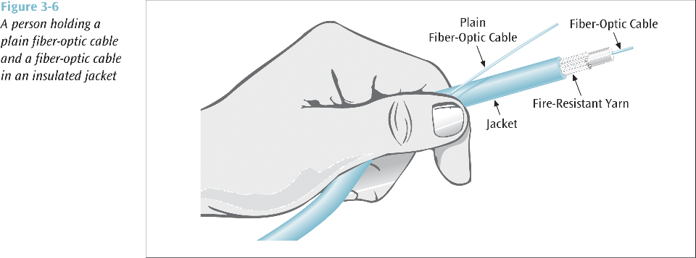
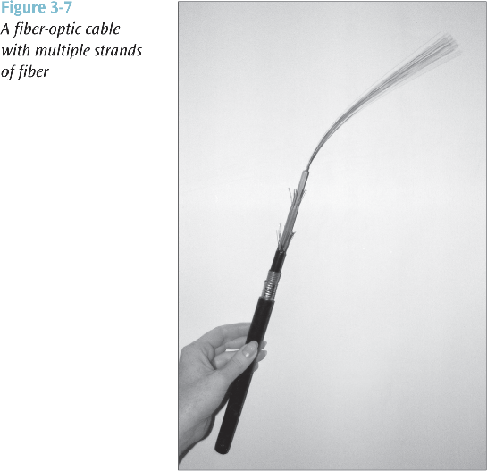
Types of Cable: Fiber Optic
Fiber optic cable
Consists of glass fiber thinner than human hair
Uses light to carry signals
Laser or light-emitting diode produces signal
Cladding: plastic sheath to protect fibers
Advantages
Light waves: high frequency means high bandwidth
Less susceptible to interference and tampering
Lighter than copper cable
Disadvantages
Difficult to use, especially for multipoint connections

Slide 42
Electromagnetic Waves
Microwaves
Frequencies below light but above 1 GHz
Unguided medium
Tightly focused for point-to-point use
Highly susceptible to interference
Applications
Large-scale Internet backbone channels
Direct satellite-to-home TV
IEEE 802.11 Wi-Fi

Slide 43
Wireless Networking
Wi-Fi (wireless Ethernet)
Short-range, local area networking
WiMAX, cellular telephone technology
Competing versions of longer range wireless networking
Bluetooth
Personal level networking

Slide 44
Wi-Fi
Access point
Hub for wireless devices
Router between wireless and wired devices
Forwards packet to destination station
CSMA-CA
Collision avoidance, not collision detection!

Slide 45
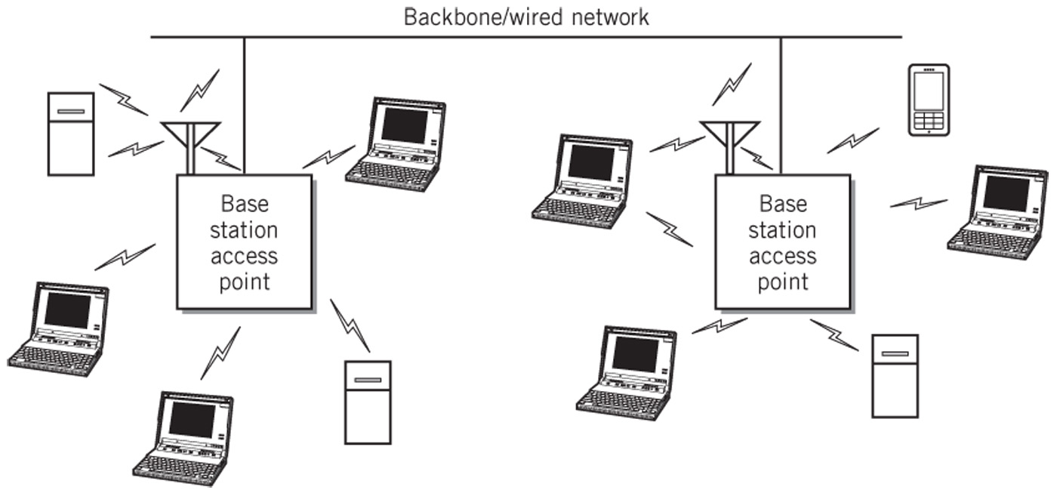
Wi-Fi Network Configuration

